Slide 1

Tableau Overview

Slide 2
History of Tableau
The company was founded in Mountain View, California in January, 2003 by Chris Stolte, Christian Chabot and Pat Hanrahan.
The founders moved the company to Seattle, Washington in October, 2003, where it remains headquartered today.
Started with version 4.1 and current version is 2020.4.
What is Tableau:
Tableau is business intelligence software that allows anyone to easily connect to data, then visualize and create interactive, sharable dashboards.
Tableau 10.1
Version 10.1.2 - Released December 20, 2016
Version 10.1.1 - Released November 6, 2016
Version 10.1 - Released November 1, 2016
Tableau 10.0
Version 10.0.4 Released December 20, 2016
Version 10.0.3 Released November 15, 2016
Version 10.0.2 Released October 11, 2016
Version 10.0.1 Released September 19, 2016
Version 10.0 Released August 15, 2016
Tableau 9.0 – 9.3.10 Release on 27- JUL-2016
Tableau 8.0 – 8.3.17 Release on 20-DEC-2015
Tableau 7.0 – 7.0.21 Released on 08-JAN-2014
Tableau 6.0 – 6.1.12 Released on 11-JAN- 2013
Tableau 5.0 – 5.2.9 Released on 23-JUN-2011
Tableau 4.1 - 4.1.9 Released on 04-AUG-2009

Slide 3
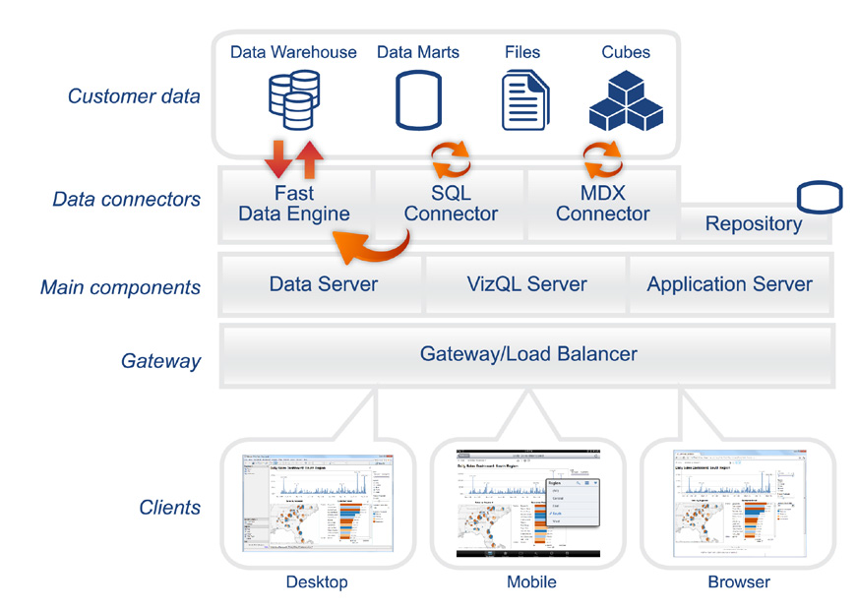
Architecture – 3 Tier

Slide 4
Data Layer
Tableau can pull data from heterogeneous data environment: data warehouses, data bases, Cubes, flat files etc. Tableau can work with all of these simultaneously.
Data Connectors
Tableau provides two modes for interacting with data:
Live connection or
In-memory/extract/
Live connection:
Tableau’s data connectors leverage your existing data infrastructure by sending dynamic SQL or MDX statements directly to the source database rather than importing all the data.
In-memory:
Tableau offers a fast, in-memory Data Engine that is optimized for analytics. You can connect to your data and then, with one click, extract your data to bring it in-memory in Tableau. Tableau’s Data Engine fully utilizes your entire system to achieve fast query response on hundreds of millions of rows of data on commodity hardware.

Slide 5
Tableau Server Components
The work of Tableau Server is handled with the following four server processes:
Application Server:
Application Server processes (wgserver.exe) handle browsing and permissions for the Tableau Server web and mobile interfaces.
VizQL Server:
Once a view is opened, the client sends a request to the VizQL process (vizqlserver.exe). The VizQL process then sends queries directly to the data source, returning a result set that is rendered as images and presented to the user. Each VizQL Server has its own cache that can be shared across multiple users.
Data Server:
The Tableau Data Server lets you centrally manage and store Tableau data sources. It also maintains metadata from Tableau Desktop, such as calculations, definitions, and groups.
Repository:
Repository stores specifications of workbooks, bookmarks, packaged data files, data extracts, and data connection files.

Slide 6
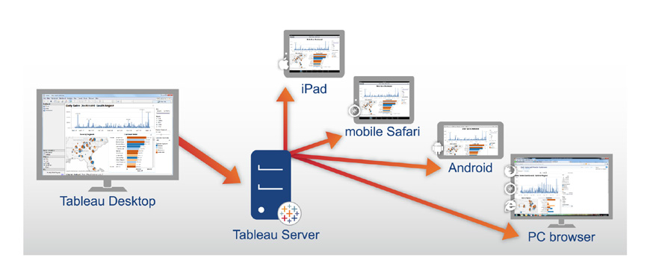
Tableau Client Components
Desktop:
Tableau Desktop is the rapid-fire authoring environment used to create and publish views, reports and dashboards to Tableau Server.
Web browsers:
Internet Explorer, Firefox, Chrome and Safari.
Mobile Apps:
Mobile Safari: Touch-optimized views are automatically served on mobile Safari
iPad app: Native iPad application that provides touch-optimized views and content browsing
Android app: Native Android application that provides touch-optimized views and content browsing

Slide 7
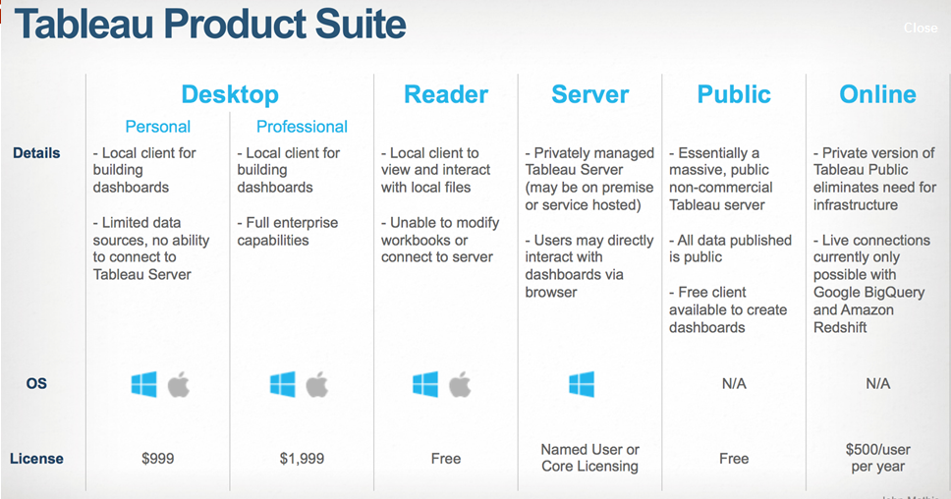
Tableau Components
Tableau Desktop
Tableau Server
Tableau Reader
Tableau Public
Tableau Online
Tableau Mobile

Slide 8
Tableau Desktop:
Tableau Desktop is a data visualization application that lets you analyze virtually any type of structured data and produce highly interactive, beautiful graphs, dashboards, and reports in just minutes.
Tableau Server:
Tableau Server is an enterprise-class business analytics platform that can scale up to hundreds of thousands of users. It offers powerful mobile and browser-based analytics and works with a company’s existing data strategy and security protocols.
Scales up: Is multi-threaded
Scales out: Is multi-process enabled
Provides integrated clustering
Supports High Availability
Is secure
Runs on both physical and Virtual Machines
Tableau Reader:
Tableau Reader is a free viewing application that lets anyone read and interact with packaged workbooks created by Tableau Desktop.
Tableau Public:
Tableau Public is a free service that lets anyone publish interactive data to the web. Once on the web, anyone can interact with the data, download it, or create their own visualizations of it.
Tableau Online: Tableau Online is a secure cloud-based solution to share, collaborate and distribute visualizations and dashboards.

Slide 9
Thank you.

